Slide 1
Directing

Slide 2
Directing Topics to be covered
Concepts within Directing
Motivation
Coordination
Communication
Leadership
Notes:
The managerial function of directing is like the activities of a teacher in a classroom. In
order to teach, a teacher has to guide his students, maintain discipline, inspire them
and lead them to the desired goal. It is a very important function in the management of any
enterprise. It helps the managers in ensuring quality performance of jobs by the employees
and achievement of organisational goals. It involves supervision, communication and
providing leadership to the subordinates and motivating them to contribute to their best of
capability.

Slide 3
What is Directing?
Planning, organizing & staffing are preparations for doing the work – Directing gets the job done; Hence it is ‘Management in action’
That aspect of management which deals directly with motivating, supervising, guiding and influencing sub-ordinates to meet the manager’s expectation and contribute towards the achievement of organizational objectives
Notes:
Managers plan and take decisions. They organise to define the work and create suitable
positions in the enterprise. People are employed to perform the jobs, but the actual work
of getting the job done comes under the directing function. Thus, directing is ‘management
in action’.
directing is concerned with instructing, guiding, supervising and inspiring people in
the organisation to achieve its objectives. It is the process of telling people what to do and
seeing that they do it in the best possible manner.
Direction is that inert-personnel aspect of management which deals directly with influencing, guiding, supervising, motivating sub-ordinate for the achievement of organizational goals.

Slide 4
What does it constitute
Motivation
Inspiring, stimulating or encouraging the sub-ordinates with zeal to work.
Coordination
Supervising & ensuring that subordinates carryout their assignments as scheduled
Communication
Leadership
Passing information, experience, opinions, forming a bridge of understanding, to convey what is to be done and explain how to do it
Guiding and influencing the work of subordinates in a desired direction.

Slide 5
Importance of Directing
Considered life-spark of the enterprise – it sets in motion the action of people
Provides guidance to the subordinates
Helps them strive to do their best
Enables in maintaining discipline and rewarding those who do well.
Ensures work is performed as per instructions and well coordinated
Creates appropriate work environment and builds up the right team spirit
Notes:
It is considered life-spark of the enterprise which sets it in motion the action of people because planning, organizing and staffing are the mere preparations for doing the work. Plans remain mere plans unless they are put into action.
In the absence of direction, subordinates will have no idea as to what to do.
They will probably not be inspired to complete the job satisfactorily. Implementation of plans is, thus, largely the concern of Directing function. As a function of management, directing is useful in many ways.

Slide 6

MOTIVATION
“The starting point of all achievement is desire. Keep this constantly in mind. Weak desire brings weak results, just as a small amount of fire makes a small amount of heat.”
-Napoleon Hill

Slide 7
Motivation is the willingness to exercise high levels of effort towards organizational goals, conditional by the effort’s ability to satisfy some individual needs.

Slide 8
Motivation
Defined as the psychological forces within a person that determine:
1) direction of behavior in an organization;
2) the effort or how hard people work;
3) the persistence displayed in meeting goals.
Intrinsic Motivation: behavior performed for its own sake.
Motivation comes from performing the work.
Extrinsic Motivation: behavior performed to acquire rewards.
Motivation source is the consequence of an action.
Notes:
Motivation refers to they way in which urges, drives, desires, aspirations, strivings or needs direct, control or explain the behavior of human being – McFarland.
Motivation is the process that account for an individual’s intensity, direction and persistence of effort toward attaining a goal- Stephen P. Robbins.

Slide 9
How does Motivation work?
It is a process that starts with with a physiological or psychological deficiency or need that activates behavior or a drive that is aimed at a goal or incentive.

Slide 10
Needs (desires or wants):
Example: need for water/ rood.
Drives: Drives or motives are specific condition that directs an organism towards its goal.
Goal: Attainment of an appropriate goal.
Incentives: Alleviation of need/reduction of the drive & Relief when the goal is reached.

Slide 11
Motivation Process
Needs- satisfaction chain
NEEDS
Which gives rise to
WANTS
Which cause
TENSION
Which give rise
ACTION (OR) BEHAVIOR
Which result in
SATISFACTION
GOAL
DEFENCE MECHANISM
Aggression
Compromise
Withdrawal
FRUSTRATION

Slide 12
Importance of Motivation
Motivation is important to organizations because in conjunction with ability and environment it determines performance.
P=f(M, A, and E).
P-Performance.
A-Ability.
M-Motivation.
E-Environment.

Slide 13
What motivates Employees?
Clear Expectations & Goals
Materials and Resources
Accurate/timely feedback
Interesting work
Challenges
Responsibility
Recognition
Respect
Being Informed
Being Listened to
Being Treated fairly
Opportunities for growth/advancement
Autonomy
Participation in decision-making
Being a Member of team

Slide 14
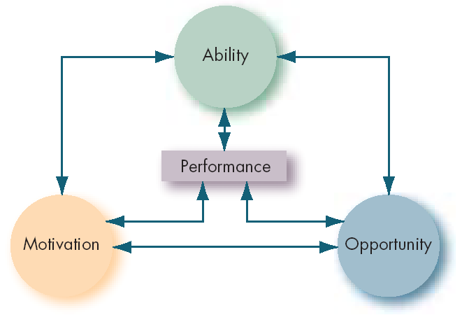
Motivation & Performance

Slide 15
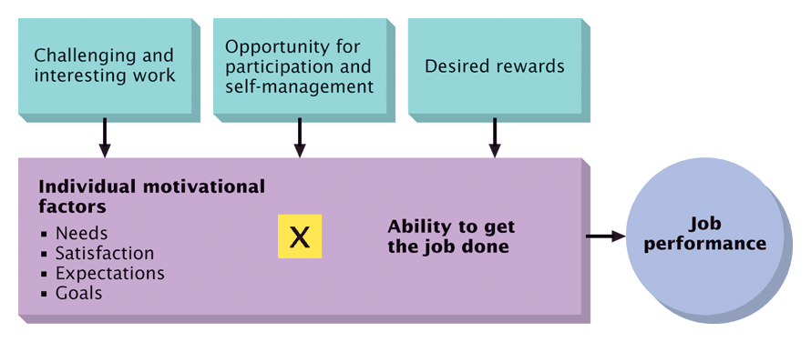
Relationship with Job Performance

Slide 16
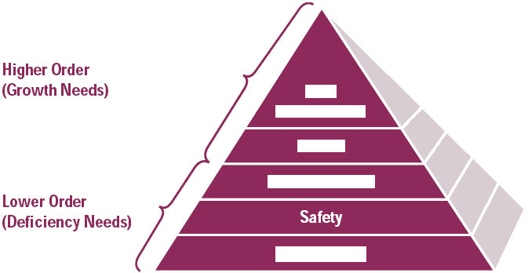
Maslow’s Hierarchy of Needs
Self-
Actualization
Esteem
Social and Love
Safety
Physiological

Slide 17
Hierarchy of Needs
Need Level
Description
Examples
Self-
Actualization
Realize one’s
full potential
Use abilities
to the fullest
Esteem
Feel good
about oneself
Promotions
& recognition
Belongingness
Social
interaction, love
Interpersonal
relations, parties
Safety
Security, stability
Job security,
health insurance
Physiological
Food, water,
shelter
Basic pay level
to buy items
Lower level needs must be satisfied before higher needs are addressed.

Slide 18
Expectancy Theory
Developed by Victor Vroom and is a very popular theory of work motivation.
Vroom suggests that motivation will be high when workers feel:
High levels of effort lead to high performance.
High performance will lead to the attainment of desire outcomes.
Consists of three areas:
Expectancy, Instrumentality, & Valence.

Slide 19
Expectancy, Instrumentality & Valence
Expectancy
the perception that effort (input) will result in a level of performance.
You will work hard if it leads to high performance.
You would be less willing to work hard if you knew that the best you would get on a paper was a D regardless of how hard you tried.
Instrumentality: Performance leads to outcomes.
Workers are only motivated if they think performance leads to an outcome.
Managers should link performance to outcomes.
Valence:
How desirable each outcome is to a person.
Managers should determine the outcomes, the workers want most.

Slide 20
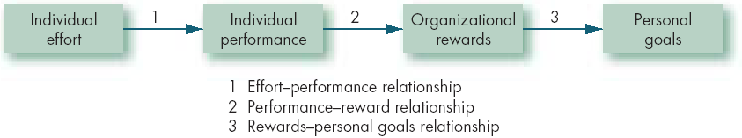
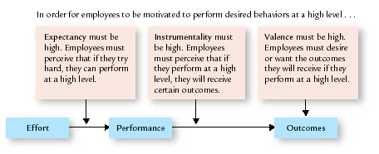

Slide 21
Effort- performance relationship: The probability perceived by the individual that exerting a given amount of effort will lead to performance.
Performance-reward relationship: The degree to which the individual believes that performing at a particular level will lead to the attainment of a desired outcome.
Rewards-personal goals relationship: The degree to which organizational rewards satisfy an individual’s

Slide 22
The multiplier effect means that all 3 must be high for high motivation
If just one value is low, motivation will be low.
This means that even if desired outcomes are closely link to performance, the worker must feel the task is possible to achieve for high motivation to result.
Managers need to consider this relationship to build a high performance firm.

Slide 23
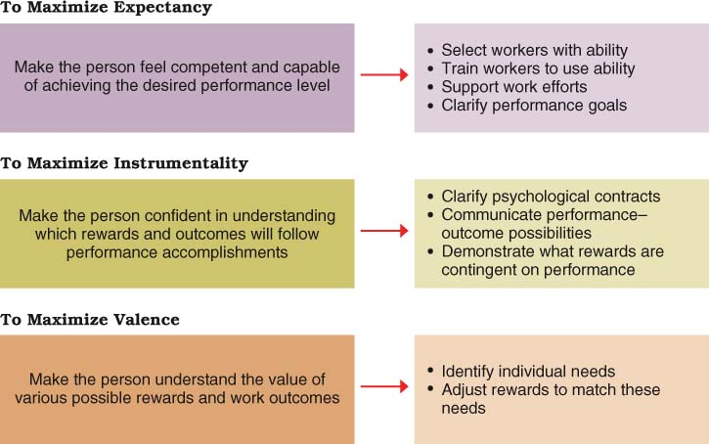
Notes:
This chart suggests how Vroom’s expectancy theory might be applied.

Slide 24
Outcomes & Inputs
Regardless of the source of motivation, people seek outcomes.
Outcome: anything a person gets from a job.
Examples include pay, autonomy, accomplishment.
Organizations hire workers to obtain inputs:
Input: anything a person contributes to their job.
Examples include skills, knowledge, work behavior.
Managers thus use outcomes to motivate workers to provide inputs.

Slide 25
Communication

Slide 26
Meaning
Communication is a basic organisational function, which refers to the process by which a person (known as sender) transmits information or messages to another person (known as receiver).
Aspects:
Expression: Verbal vs. Non verbal
Channels: Formal vs. Informal
Directional flow: Upward, downward, horizontal
Notes:
Communication does not always flow from supervisor to subordinate. It can also be from
a subordinate to a supervisor. For example, subordinates can pass information to the
supervisor about the faults/problems at the assembly line. Thus, it is a two way process.

Slide 27
Verbal & Non Verbal
Verbal modes may be oral & written:
Oral: Face to face interviews, meetings, seminars & use of telephone or intercom
Written: Letters, circulars, notices and memos.
Non-verbal communication –
facial expressions, body gestures like wave of hand, a smile or a frown etc.
This is also termed as the gestural communication.

Slide 28
Formal vs. Informal
The path through which information flows is called channel of communication.
Formal channels: the paths of communication which are based on relationships formally established by the management
General Manager communicates a decision to the production manager, who may then issue instructions to the foremen.
A worker applying to his supervisor for leave; He/she may approve it & forward it to the Manager (HR)
Informal channels: Channels that carry communication that takes place on the basis of informal or social relations among staff
Any sharing of information between a production supervisor and an accountant, as they happen to be friends
Notes:
The path through which information flows is called channel of communication.
In every organisation, both formal and informal channels exist
The paths of communication which are based on management established relationships establish are the formal channels.
For example, the General Manager communicates a decision to the production manager who may then issue orders or instructions to the foremen.
It may also be like a worker applying to his supervisor for a loan from the GPF account. He/she forwards it to the Manager Accounts who finally sends it to the General Manager (Finance) for approval.
Communication, which takes place on the basis of informal or social relations among staff is called informal communication. For example, any sharing of information between a production supervisor and an accountant, as they happen to be friends or so.
Mostly informal channels are used due to friendly interaction of members of an organisation. In fact, it may be purely personal or related to organisational matters.

Slide 29
Directional Flows
Upward: From bottom to top
When employees report, suggest, or communicate ideas or make any request to the superior
a foreman reports breakdown of machinery to the factory manager
when a typist drops a suggestion in the suggestion box
It encourages employees to participate actively in the operations of their department.
Their sense of responsibility increases when the problems affecting their jobs are heard by their supervisors
Downward: From top to bottom
When instructions, commands, orders or other ideas are communicated by superiors down the hierarchy
When the General Manager orders supervisors to work overtime
Similarly, communication of work assignments, notices, requests for performance, etc. through bulletin boards, memos, reports, speeches, meetings, etc, are all forms of downward communication.

Slide 30
When it takes place among managers of the same rank it is known as horizontal communication.
When communication is made between people who are neither in the same department nor at the same level of organisational hierarchy, it is called diagonal communication.

Slide 31
Purpose
Communication is the means through which delegation and decentralisation of authority is successfully accomplished in an organisation.
To convey orders, instructions, or policies & procedures so as to bring desired changes in the performance and or the attitude of employees.
Conveys subordinates’ doubts & ideas about the work to be done to superiors

Slide 32
Importance
Helps employees to understand their role clearly and perform effectively.
Instrumental in achieving clarity, mutual understanding & co-ordination which leads to industrial harmony and increased productivity
Improves managerial efficiency and ensures staff cooperation
Effectively moulds attitudes and builds up employees’ morale.

